Slide 1
NAAC Sponsored National Workshop on Teaching, Learning & Research in the NAAC RAF perspective 14-15 February 2022
EVENT REPORT

Slide 2
Objectives
The Workshop was intended to make teachers and academicians aware of the
opportunities and challenges of the changing educational sector
with special emphasis on the development of new Teaching and Learning Strategies
consistent with the Revised NAAC Accreditation Framework
and National Education Policy 2020

Slide 3
Expected Outcome
The participants will be able to
to analyze the metrics of NAAC Revised Accreditation Framework and Standard Operation Procedures (SOP)
to identify Outcome based Education and student centric methodologies in teaching and learning
to understand the impact of NEP 2020 on NAAC RAF

Slide 4
Participants
National Participants | 78
Within State | 107
Faculty from Bishop Moore College | 52
TOTAL Registered Participants | 237

Slide 5
Workshop Sessions
Inaugural Session
Six Invited Lecture Sessions
Valedictory Session

Slide 6
Day 1: Inaugural Session (10.00 am-11.00 am)
Prof. Dr. Gabriel Simon Thattil
IQAC Director &
Dean of Commerce
University of Kerala
Inaugural Address
“Scenario in the Higher Education Sector in India post NEP 2020”

Slide 7
Day 2: Lecture 1 (11.30 am – 1.00 pm) “Innovations and Best Practices in Teaching and Learning”
Prof. Dr. Gabriel Simon Thattil
How to adapt ourselves to changing educational scenario ?
How to make teaching-learning process effective?
How to find and implement innovations and best practices in Teaching-Learning

Slide 8
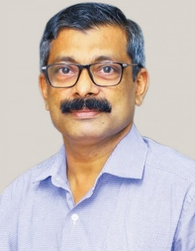
Day 2: Lecture 2 (2.00 pm – 3.30 pm) “Research, Extension & Infrastructure: NAAC RAF Perspective”
Dr. SUNIL C. MATHEW
Principal, Deva Matha College
Kuravilangad
Research and extension in NAAC RAF?
Importance of Infrastructure and maintenance in NAAC RAF?
Important points to be kept in mind while preparing SSR

Slide 9
Day 2: Paper Presentation Sessions (3.30 pm – 5.50 pm)
13 ORAL PRESENTATIONS
Best Practices
Innovations
National Education Policy
Outcome Based Education
NEP Metrics of RAF
Skill Based Education
Higher Education Sector in India

Slide 10
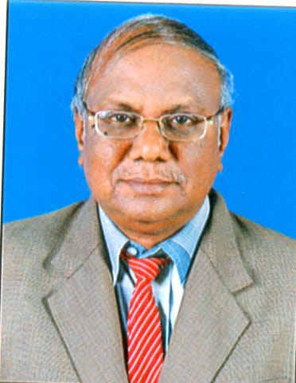
Day 2: Lecture 1 (9.30 am -10.30 am) Curricular Aspects: NAAC RAF Perspective
Dr. R. Selvam
Consultant for NAAC Accreditation Process & External Academic Auditor
Curricular Aspects in NAAC RAF point of view
Designing Certificate Courses
Ensuring Student Participation in Certificate Courses
SOP of Criterion 1-Do s and Don’ts

Slide 11
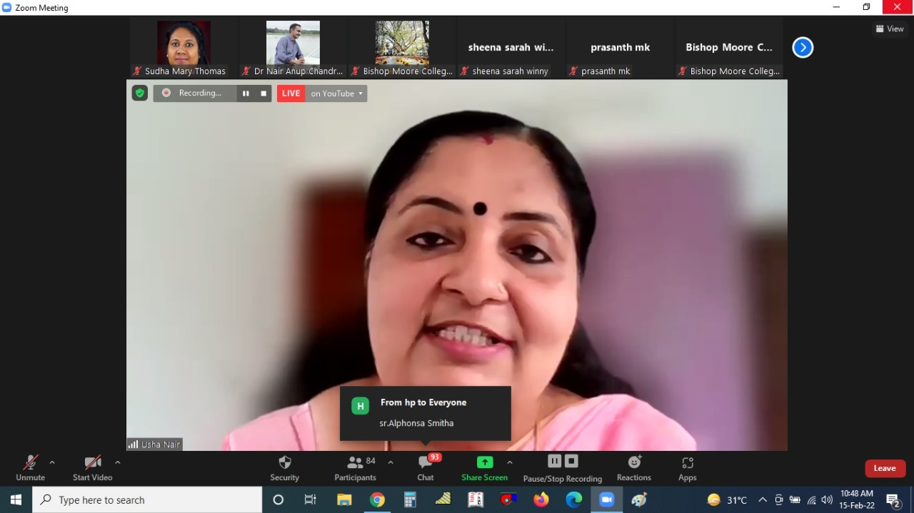
Day 2: Lecture 2 (10.45 am -12.00 pm) “Role of HEI in Student Support & Progression”
Dr. USHA NAIR
UGC Paramarsh Co-ordinator, Associate Professor
& Head of the Department of Hindi
St. Teresa’s College, Ernakulam
Student Support Mechanisms
How to track the students progression with proper documentation
Student Support and Progression in NAAC RAF
SOPs of Criterion V

Slide 12
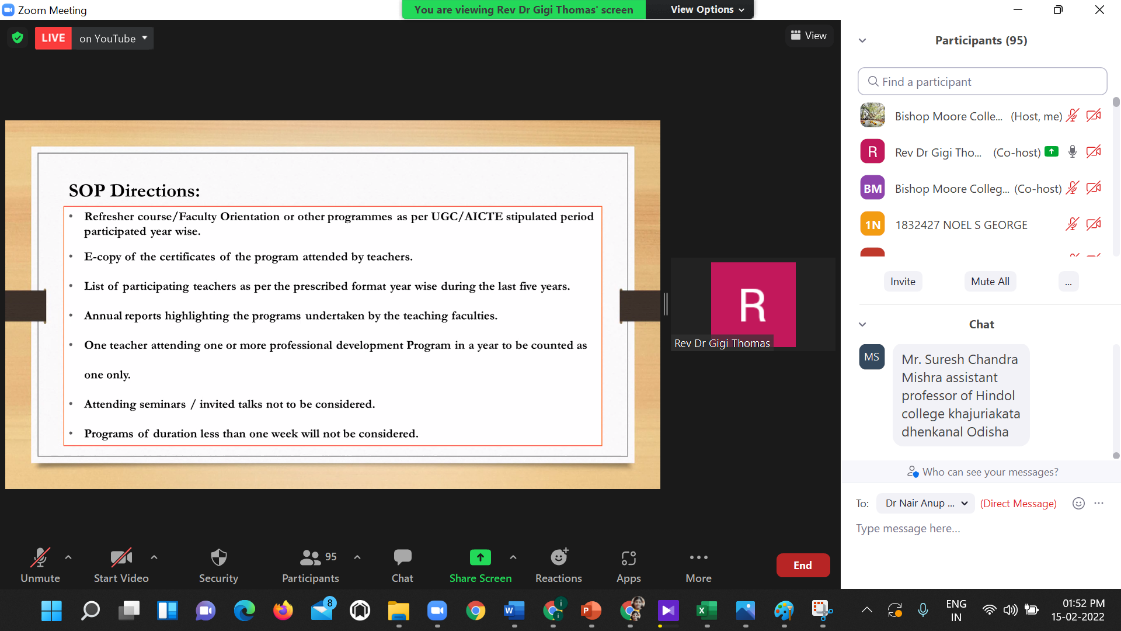
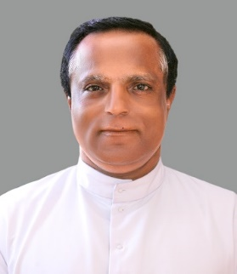
Day 2: Lecture 3 (1.00 pm -2.30 pm) “Governance and Leadership: Key aspects”
Fr. Dr. GIJI THOMAS
NAAC Visit Co-Ordinator, Accreditation Ambassador & Dean of Studies,
Mar Ivanios College, Thiruvananthapuram
NAAC RAF based approach on Governance of Leadership in Higher Education Institutions
SOPs on various metrics of Criterion VI in detail
Need for Institutional Strategic Plans

Slide 13
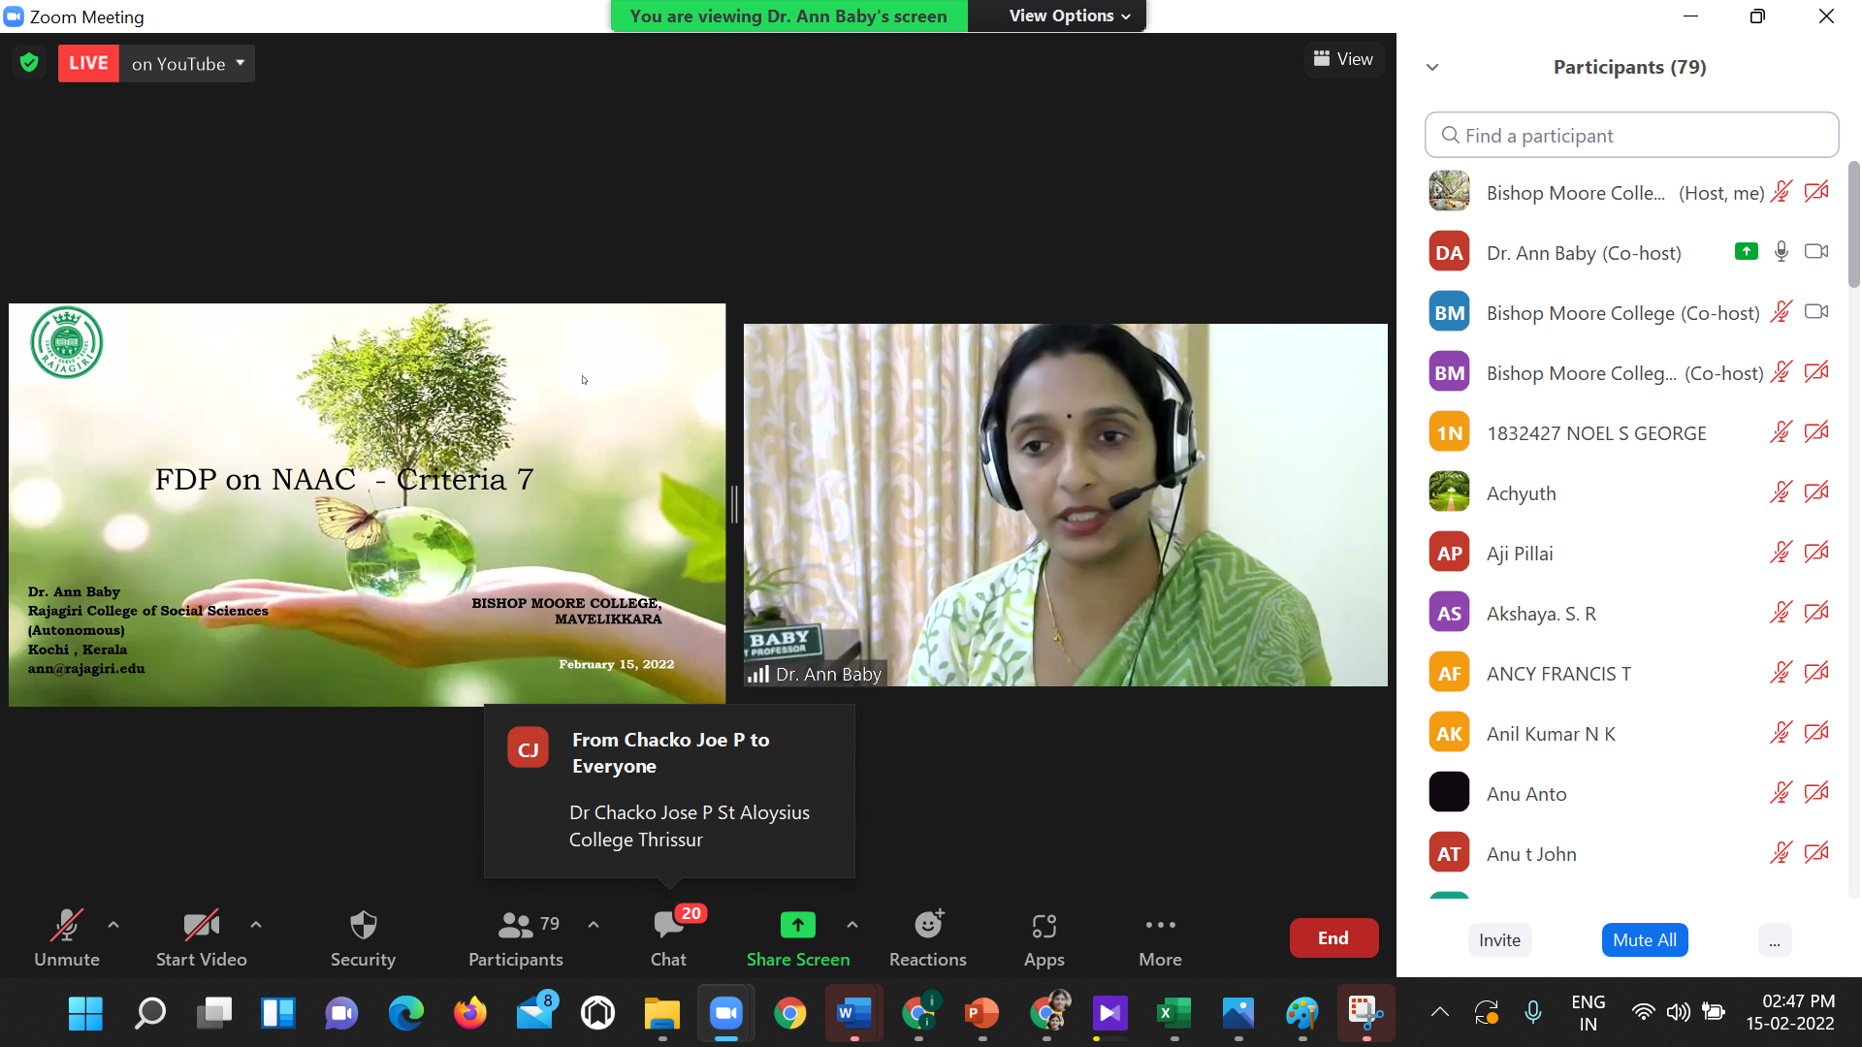
Day 2: Lecture 4 (2.45 pm -4.30 pm) “Innovations and Best Practices: NAAC RAF perspective”
Dr. ANN BABY
Assistant Professor of
Computer Science
Rajagiri College of Social Sciences, Ernakulam
Inculcating Value in students
Promoting the Use of Technology
Importance to marginalized
SOPs related to Criterion 7

Slide 14
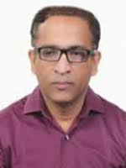
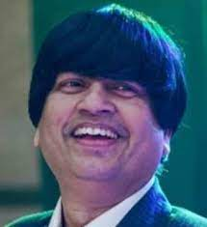
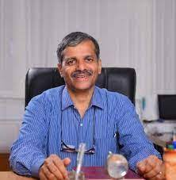
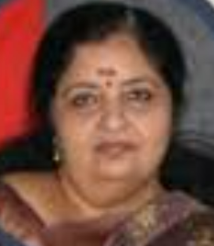
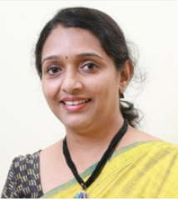
Acknowledgement
Dr. B. S.PONMUDIRAJ
Adviser, NAAC
Bangalore
Prof. SABU THOMAS
Vice Chancellor
M G University, Kottayam
Prof. Dr. GABRIEL SIMON
THATTIL
IQAC Director &
Dean of Commerce
University of Kerala
Dr. SUNIL C. MATHEW
Principal
Deva Matha College
Kuravilangad
Dr. R. SELVAM
Consultant for NAAC Accreditation Process & External Academic Auditor
Dr. USHA NAIR
Associate Professor
& Head of the Department of Hindi
St. Teresa’s College, Ernakulam
Fr. Dr. GIJI THOMAS
Dean of Studies,
Mar Ivanios College, Thiruvananthapuram
Dr. ANN BABY
Asst Prof of Computer Science
Rajagiri College of Social Sciences, Ernakulam

Slide 15
THANK YOU…………

